Slide 1


NETW211 Course Project Module 3 Azure VNet and Subnets Edward Alvarado March 2022

Slide 2
Rubric
Activity | Requirement(s) | Points
Creating a VNet with Two Subnets | Questions | 20
Deploying VMs into Subnets | Three Screenshots | 30
Verifying Connectivity between VMs | Two Screenshots | 10

Slide 3
Creating a VNet with Two Subnets
With a /24 network prefix, how many usable IPv4 host addresses are there?
Answer here: 254
2. Why is the number of available IP addresses for Subnet0 (10.0.0.0/24) or Subnet1 (10.0.1.0/24) shown as 251?
Answer here: The first four addresses in any subnet are reserved and you cannot use for host addresses and the very last address is reserved.
References:
1. https://cloudacademy.com/course/amazon-vpc-networking/vpc-subnets/#:~:text=So%20when%20working%20with%20TCP,assign%20to%20your%20host%20resources.
2. https://forums.aws.amazon.com/thread.jspa?messageID=954362

Slide 4
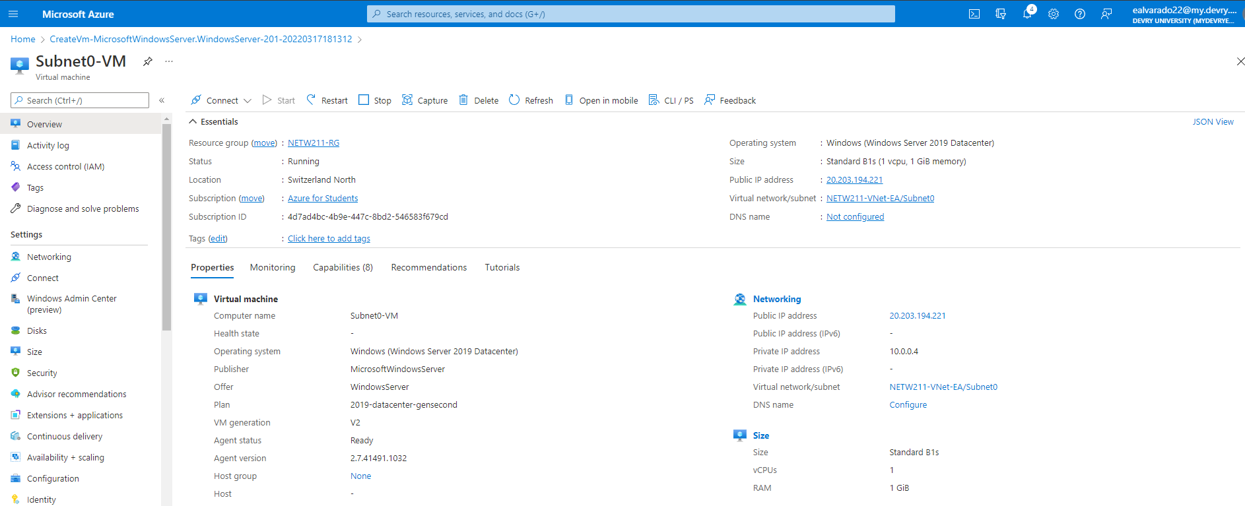
Deploying VMs into Subnets
This screenshot should show the Properties section of the Subnet0-VM page, showing the networking and size information of the VM.

Slide 5
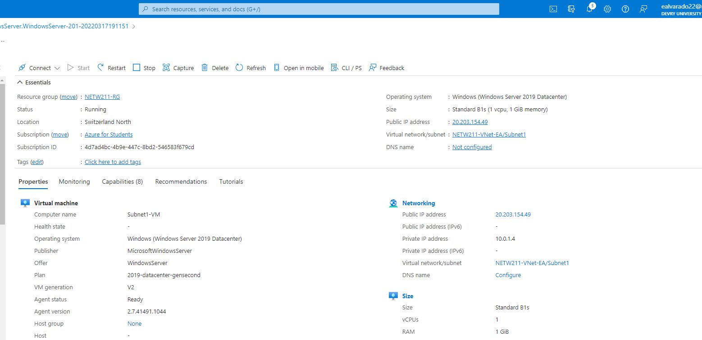
Deploying VMs into Subnets cont’d
This screenshot should show the Properties section of the Subnet1-VM page, showing the networking and size information of the VM.

Slide 6
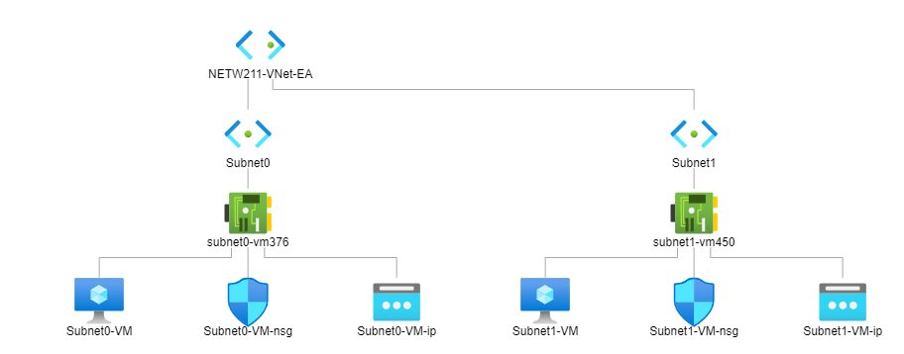
Deploying VMs into Subnets cont’d
This screenshot should show the topology diagram of your VNet (NETW211-VNet-Your Initials) with two subnets (Subnet0 and Subnet1) and one VM in each subnet (Subnet0-VM and Subnet1-VM).

Slide 7
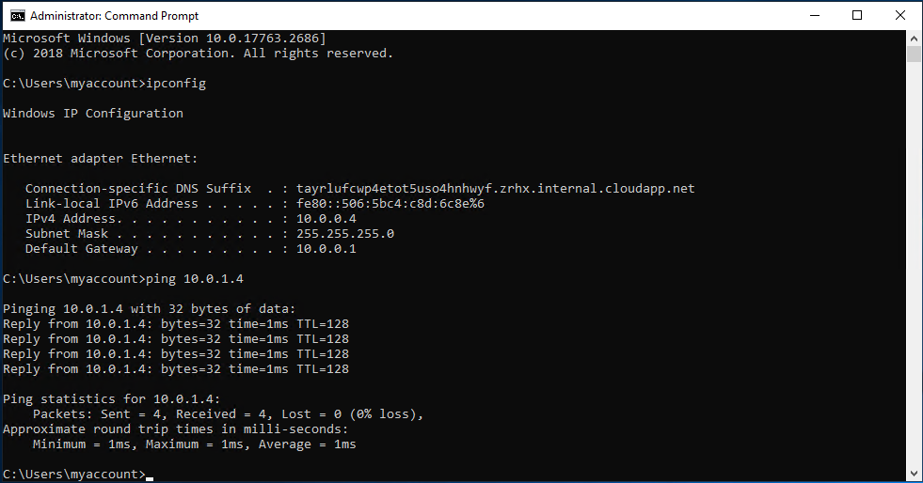
Verifying Connectivity between VMs
This screenshot should show the ipconfig and ping 10.0.0.4 results in the command prompt window, including the Subnet0-VM – 10.0.0.4 – Remote Desktop Connection window title.

Slide 8
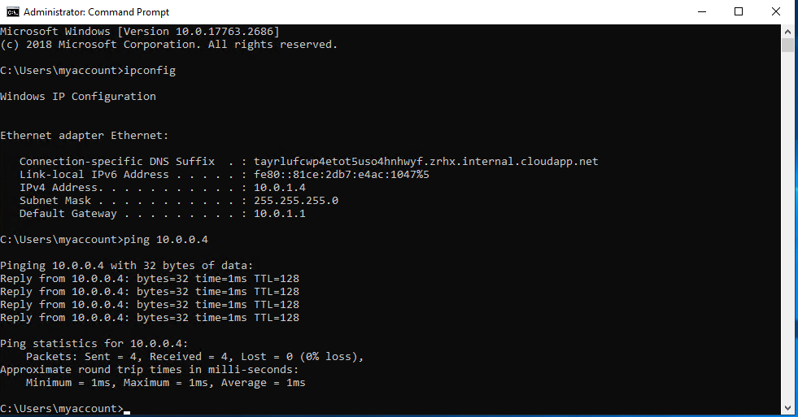
Verifying Connectivity between VMs
cont’d
This screenshot should show the ipconfig and ping 10.0.1.4 results in the command prompt window, including the Subnet1-VM – 10.0.1.4 – Remote Desktop Connection window title.

